Slide 1
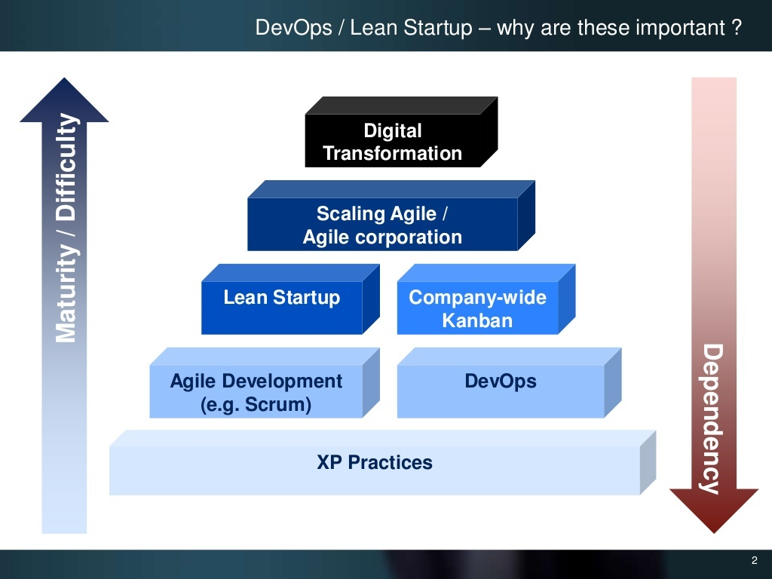
Notes:
<number>

Slide 2

Notes:
<number>

Slide 3
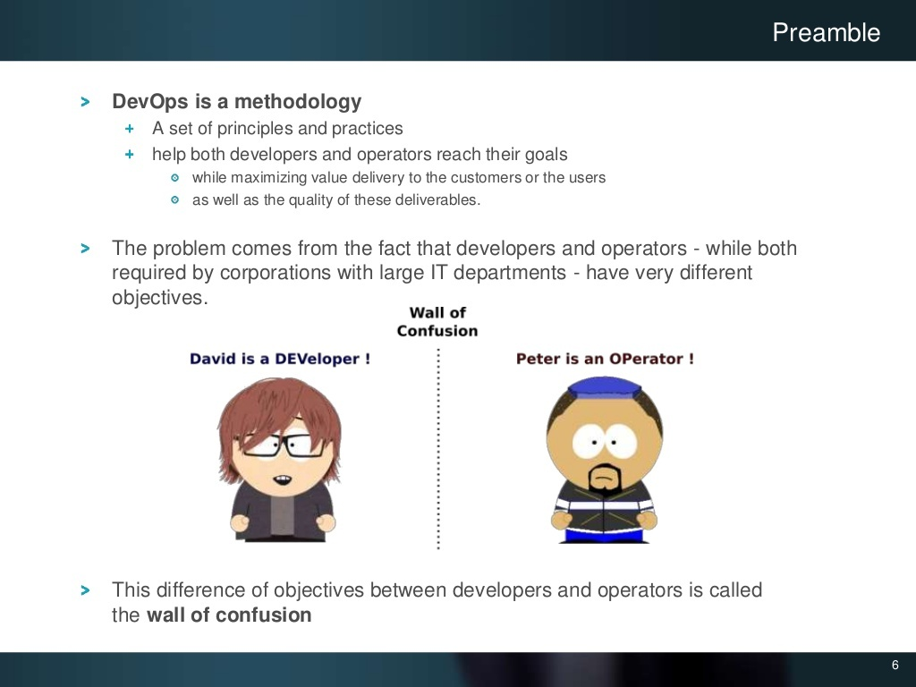
Notes:
<number>

Slide 4
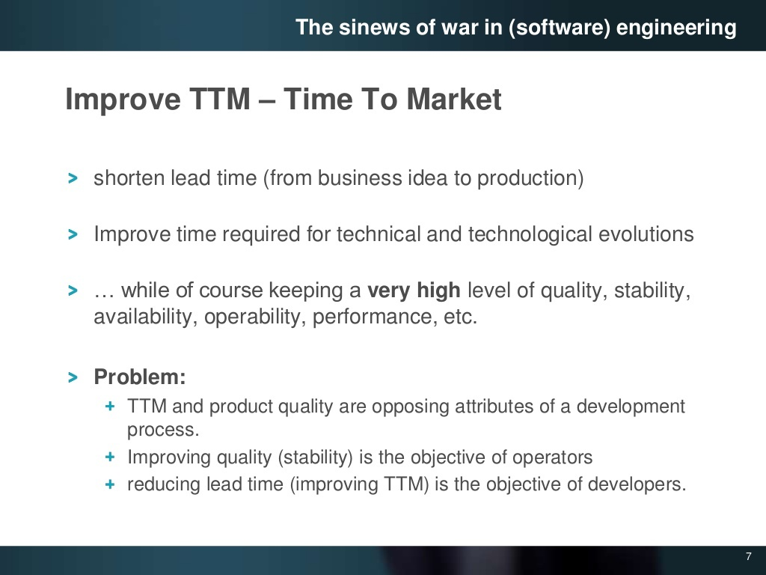
Notes:
<number>

Slide 5
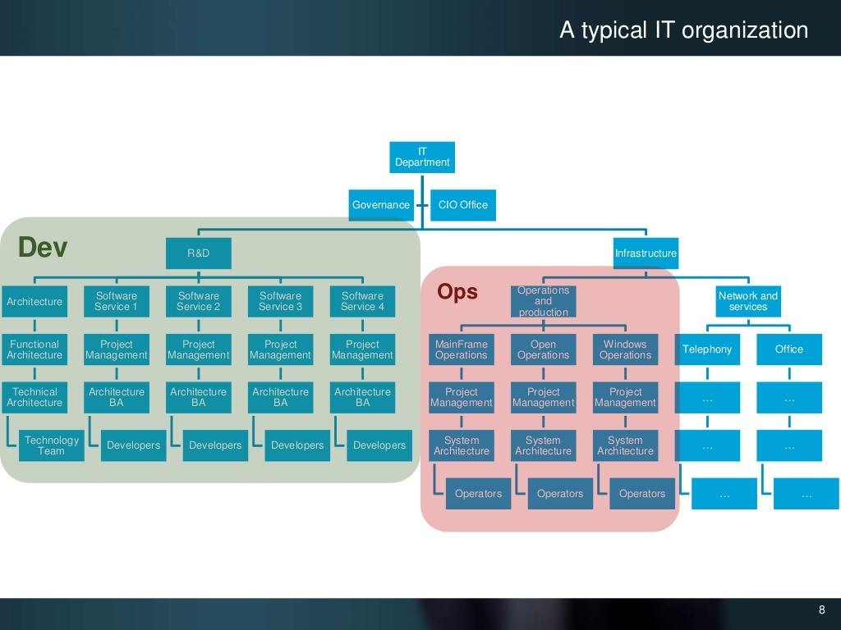
Notes:
<number>

Slide 6
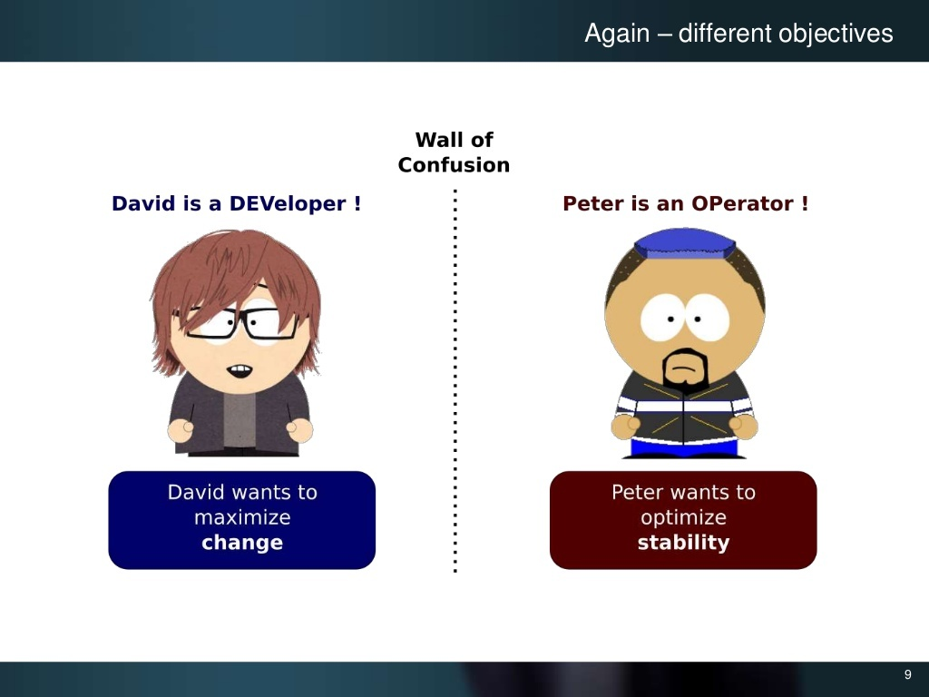
Notes:
<number>

Slide 7
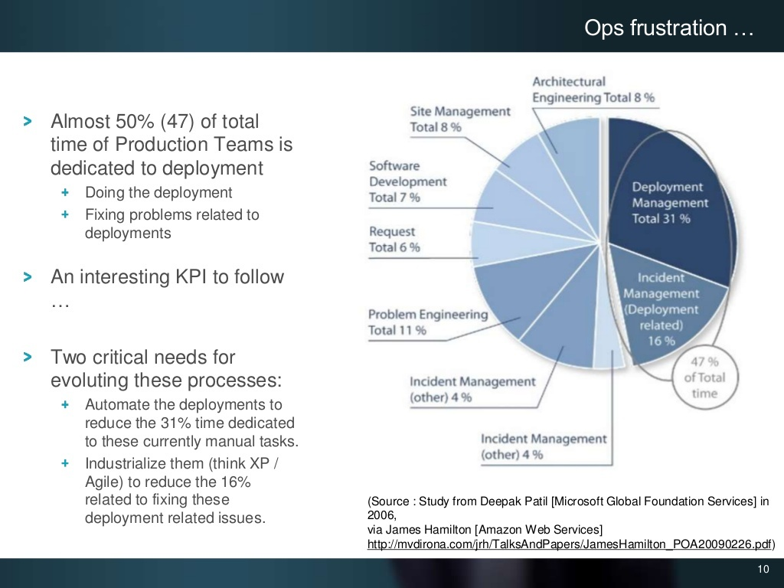
Notes:
<number>

Slide 8
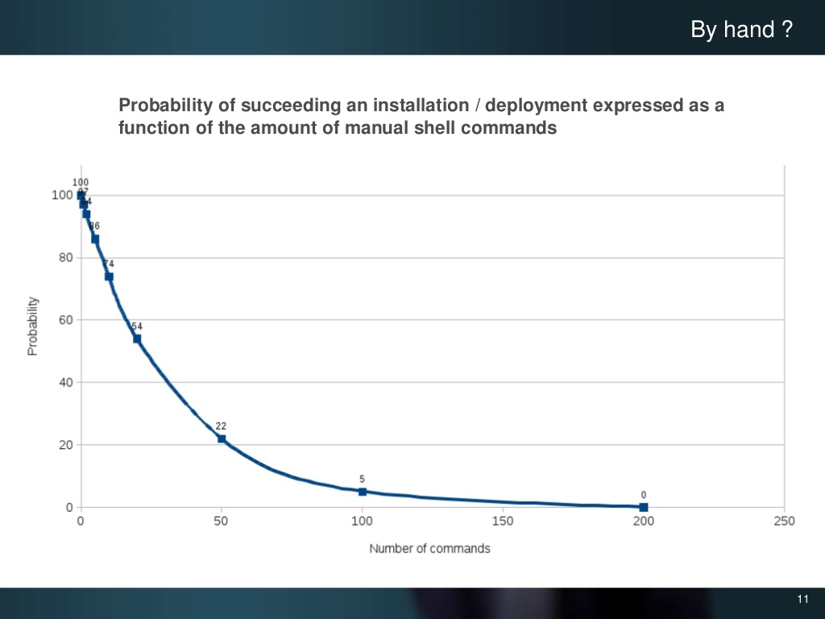
Notes:
<number>

Slide 9

Notes:
<number>

Slide 10
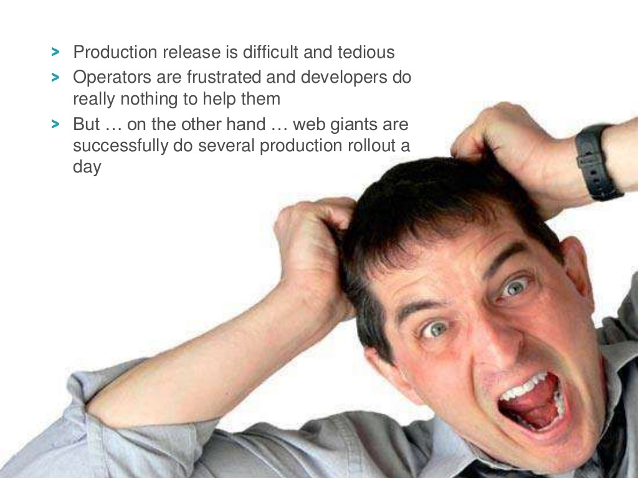
Notes:
<number>

Slide 11
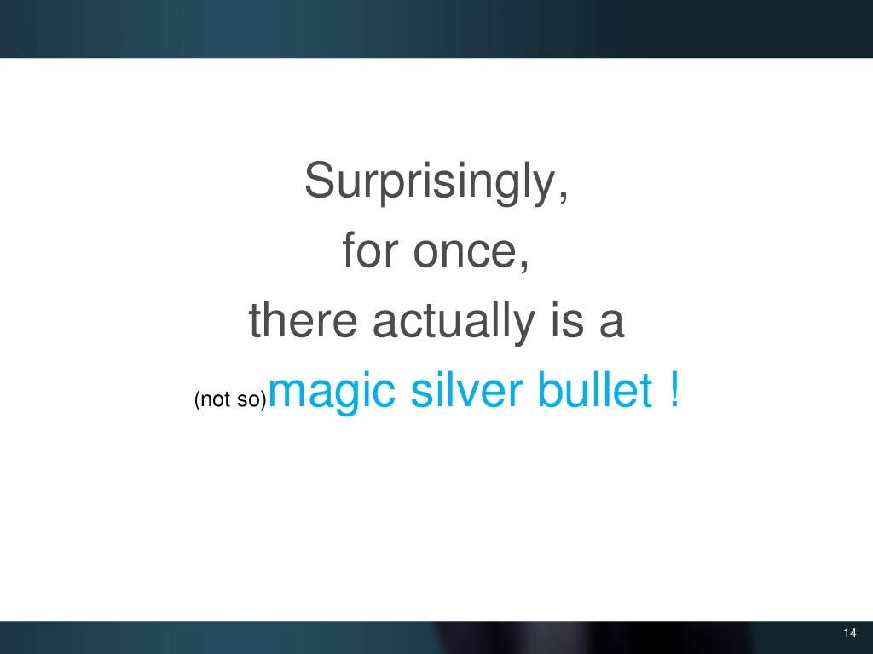
Notes:
<number>

Slide 12
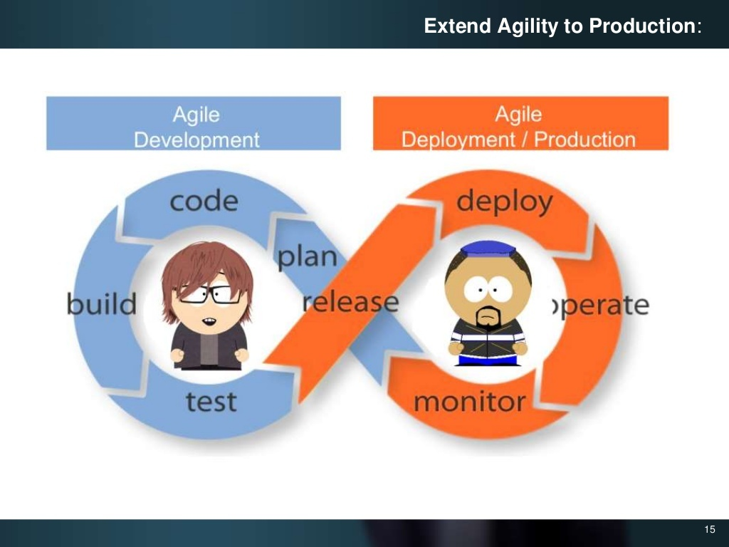
Notes:
<number>

Slide 13
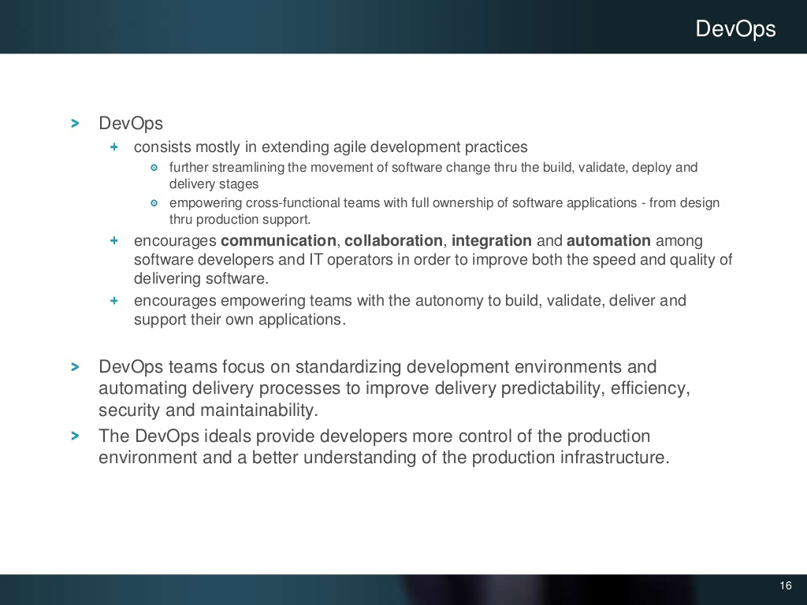
Notes:
<number>

Slide 14
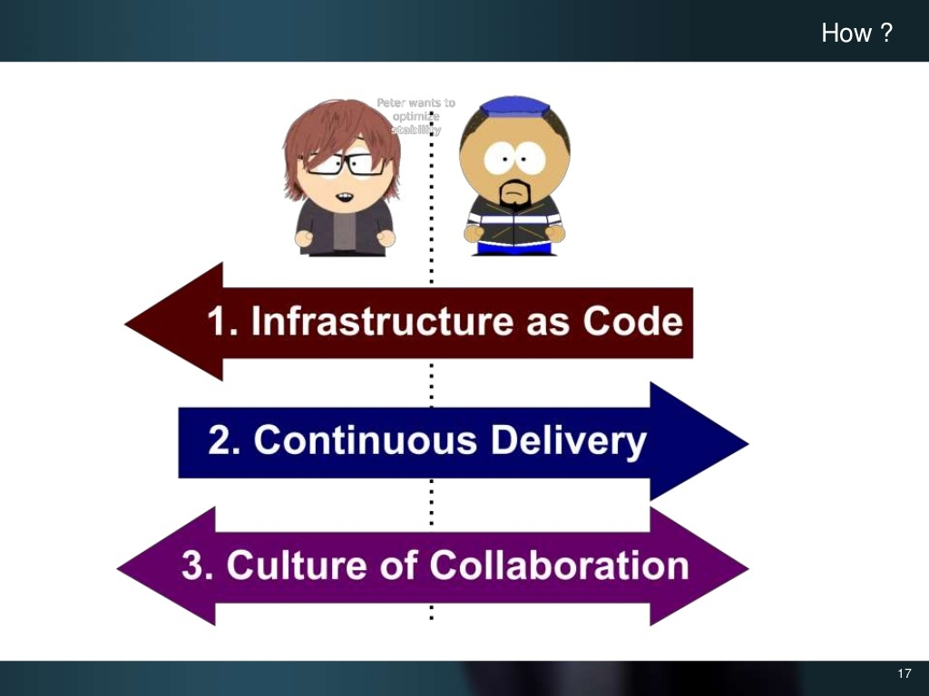
Notes:
<number>

Slide 15

Notes:
<number>

Slide 16
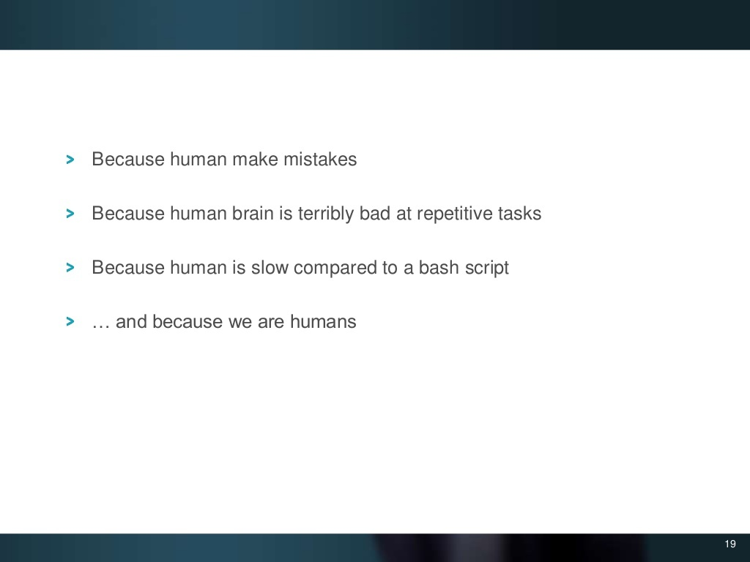
Notes:
<number>

Slide 17
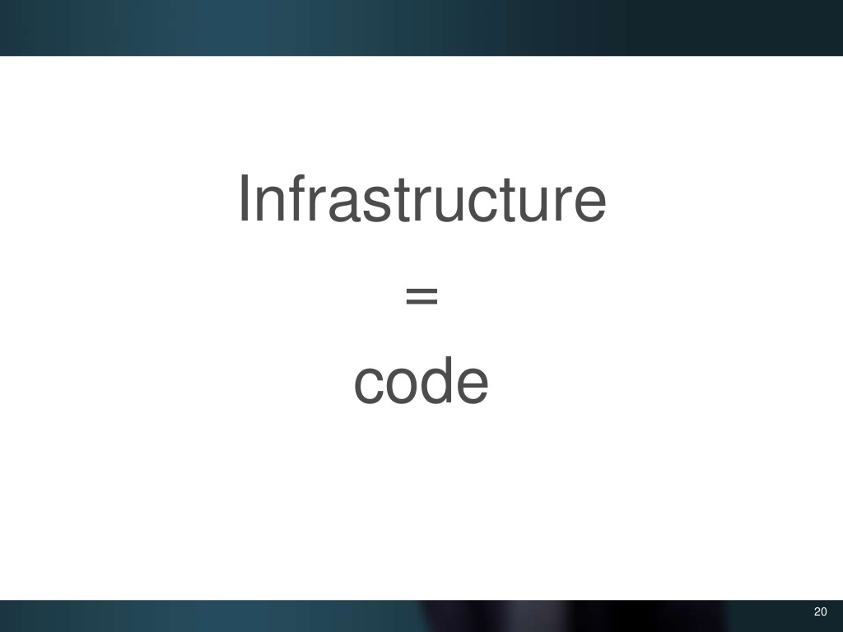
Notes:
<number>

Slide 18
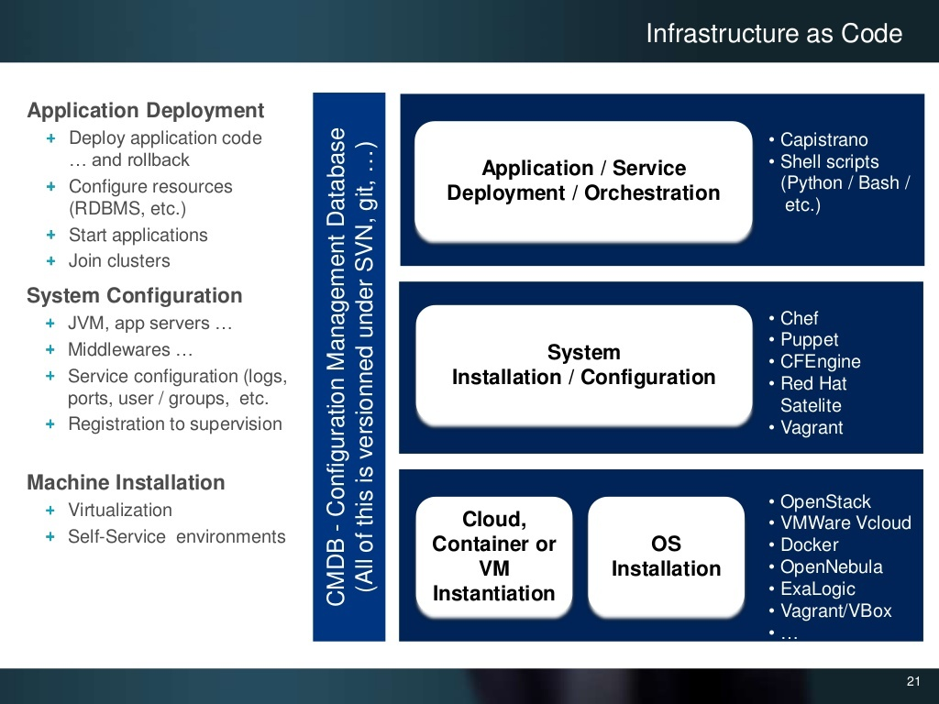
Notes:
<number>

Slide 19
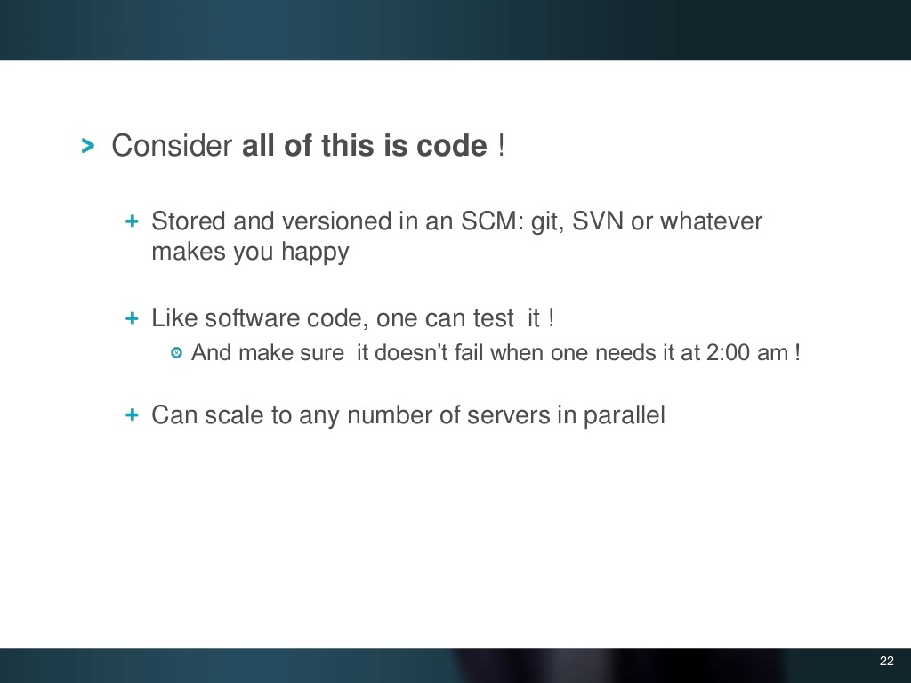
Notes:
<number>

Slide 20
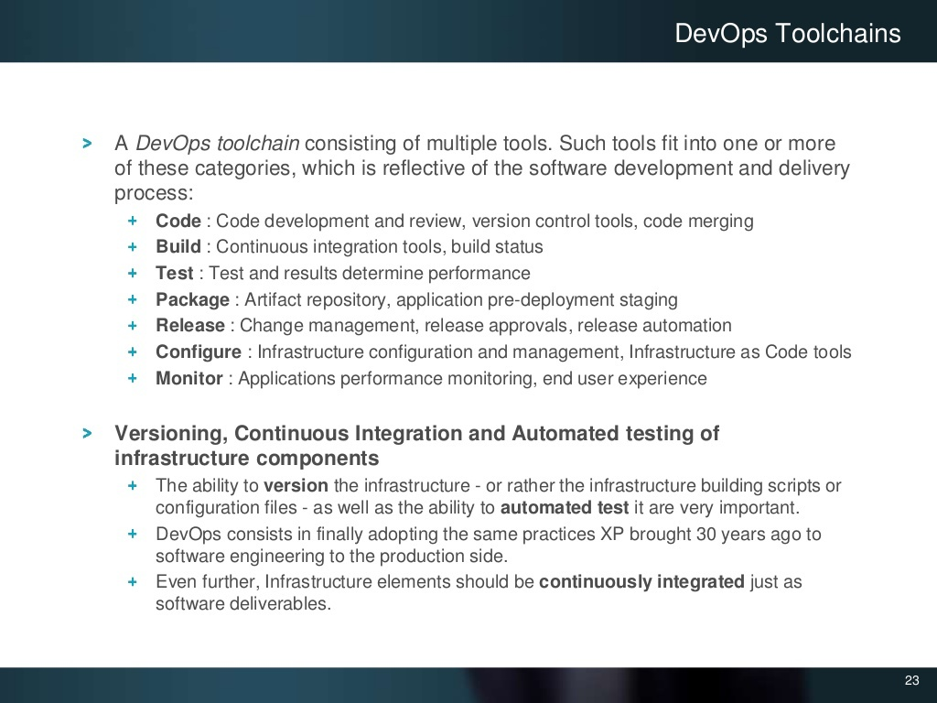
Notes:
<number>

Slide 21
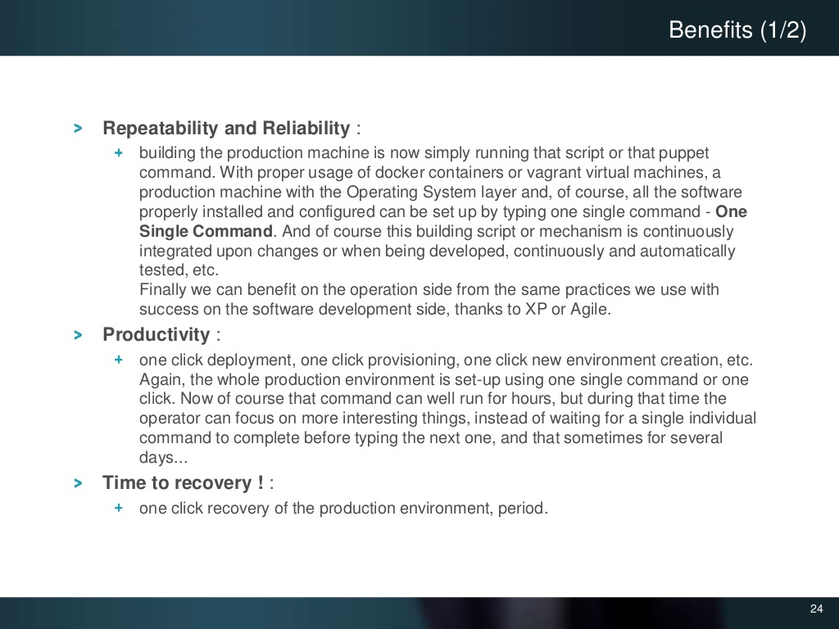
Notes:
<number>

Slide 22
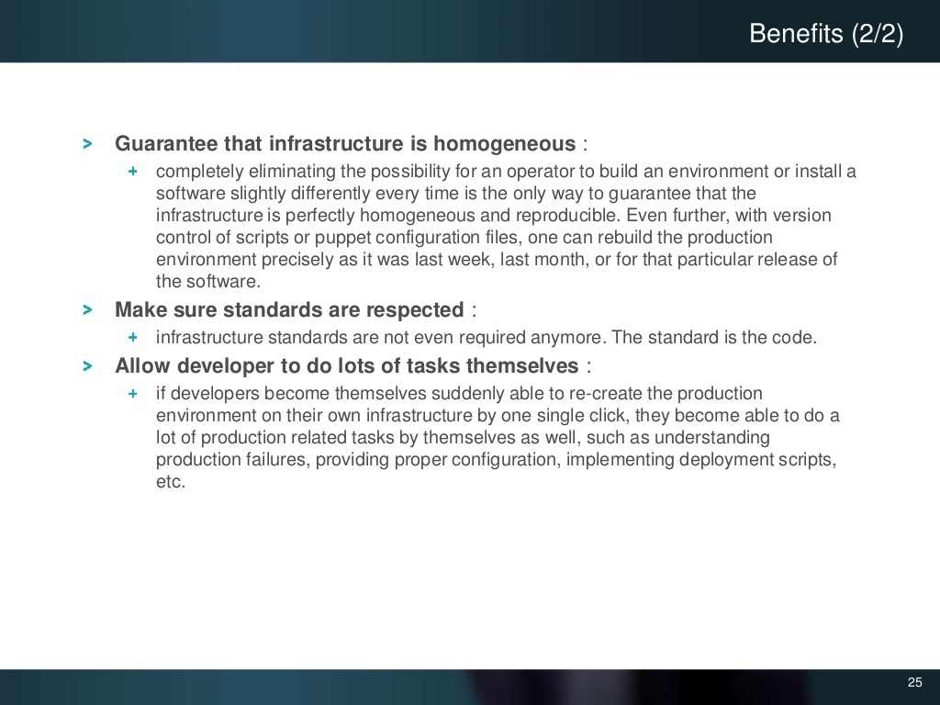
Notes:
<number>

Slide 23

Notes:
<number>

Slide 24
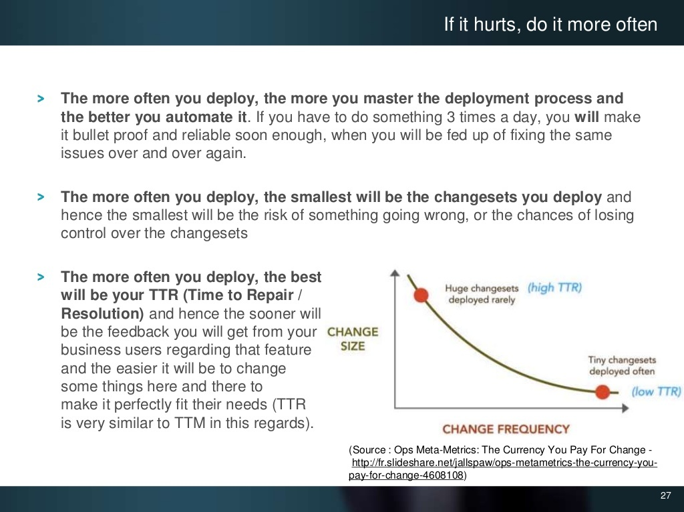
Notes:
<number>

Slide 25
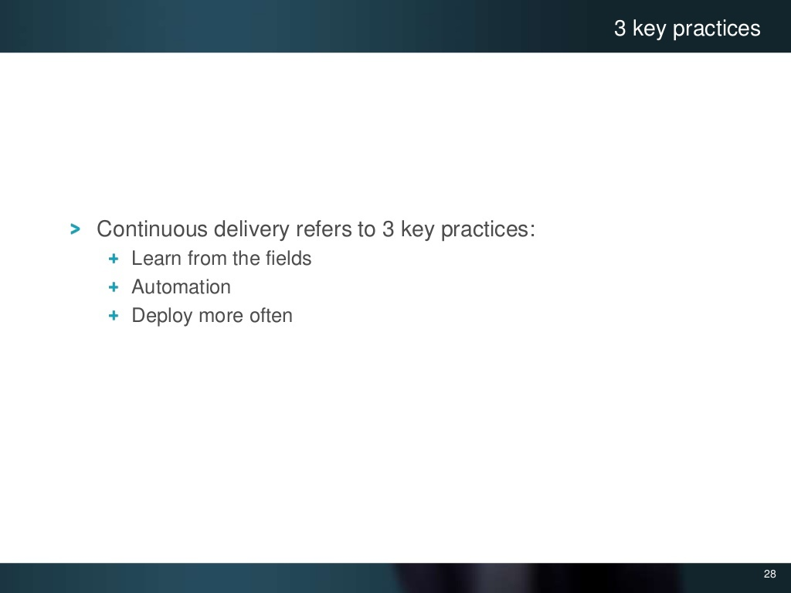
Notes:
<number>

Slide 26
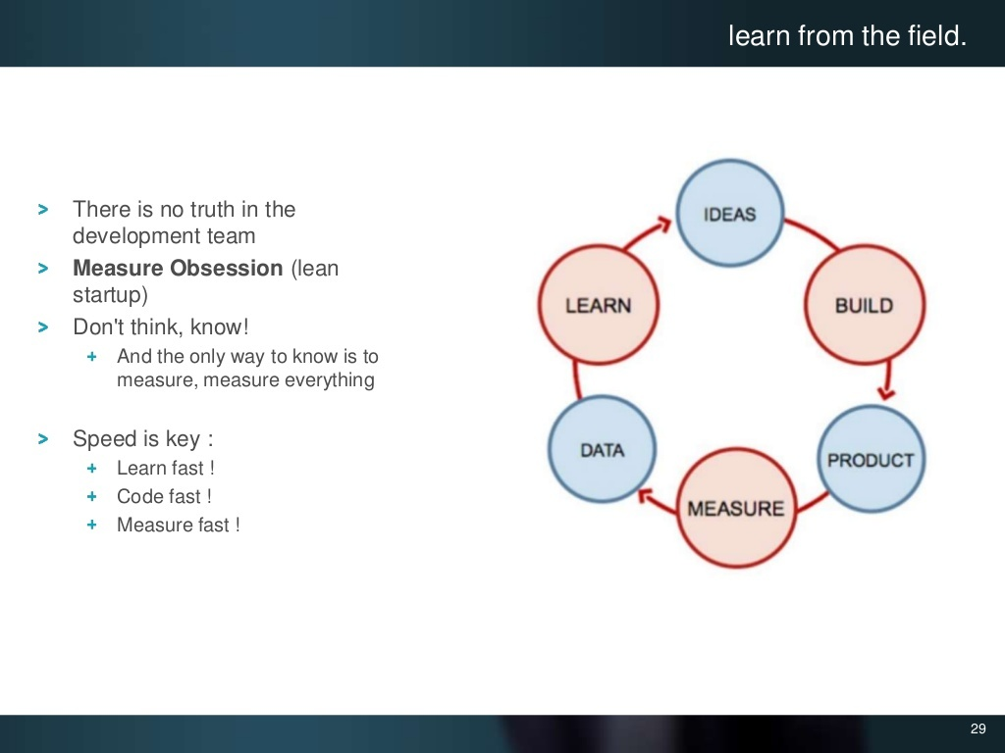
Notes:
<number>

Slide 27
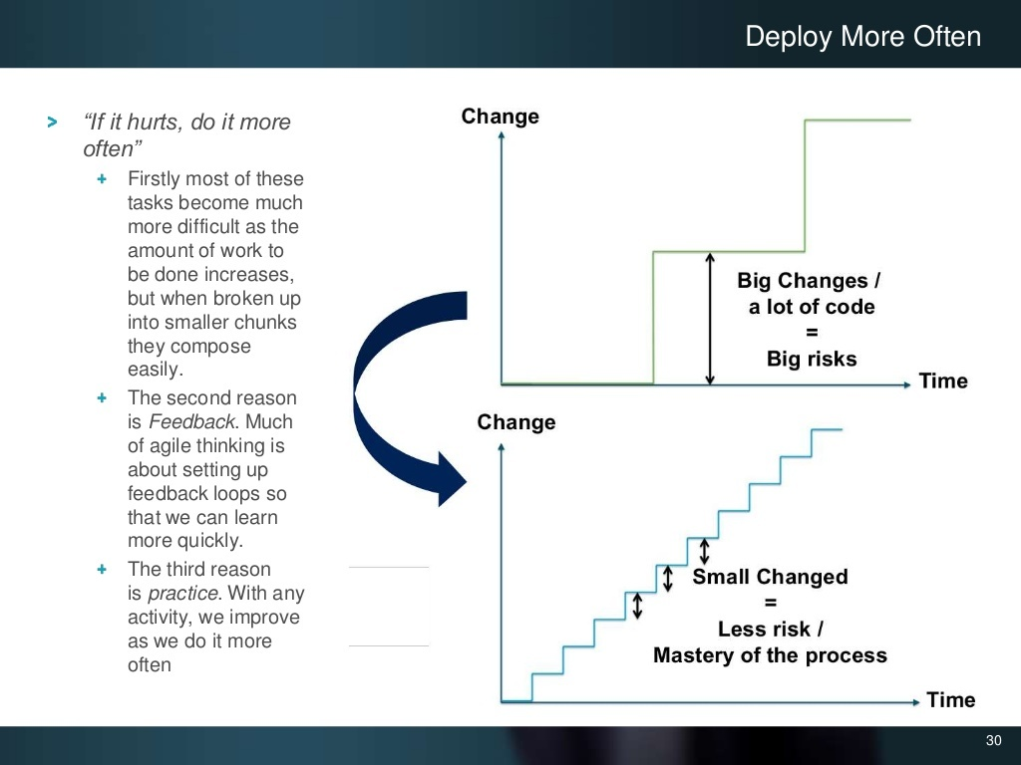
Notes:
<number>

Slide 28
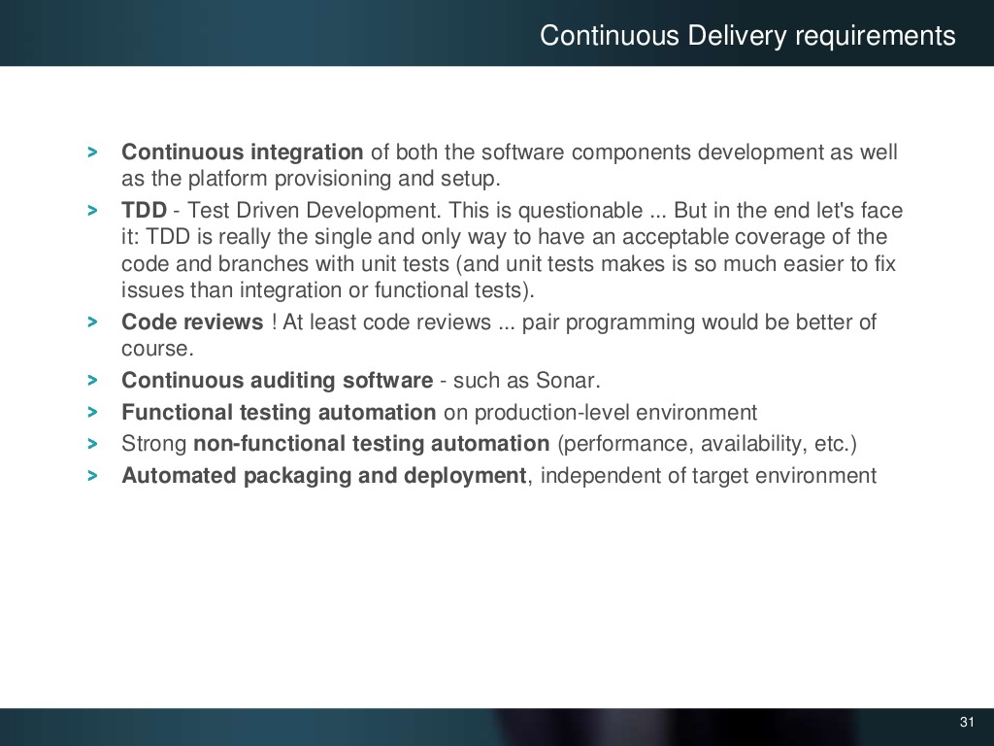
Notes:
<number>

Slide 29
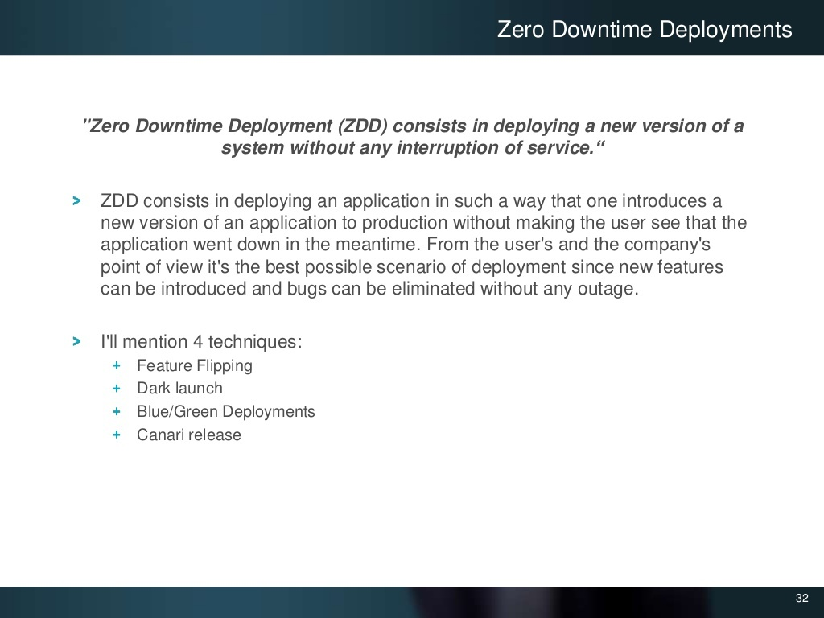
Notes:
<number>

Slide 30
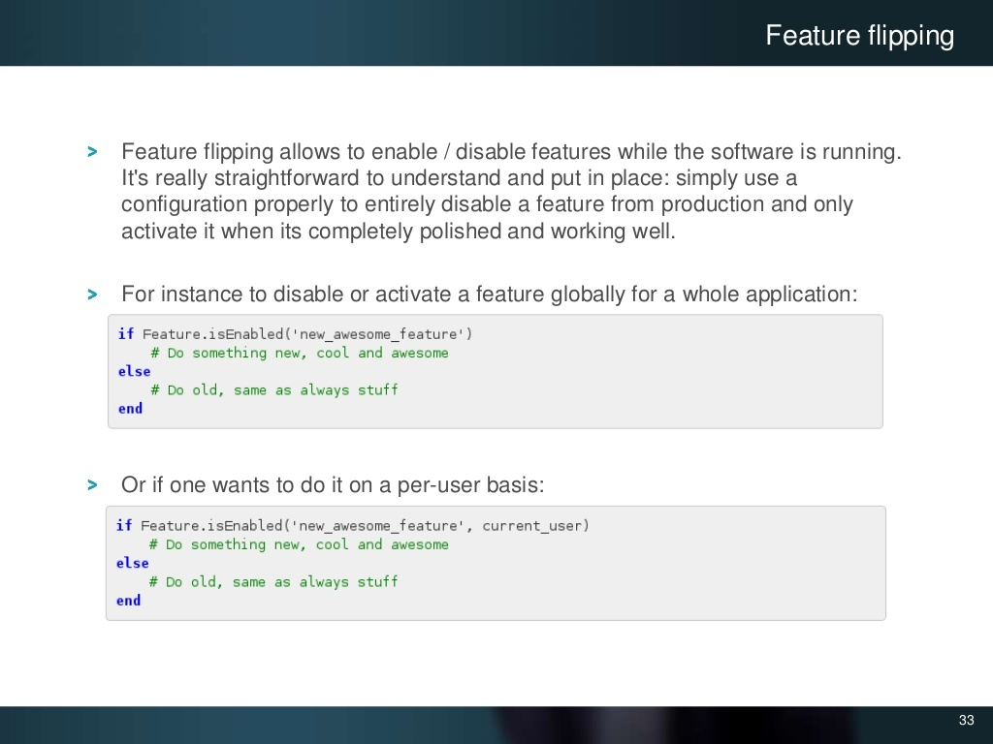
Notes:
<number>

Slide 31
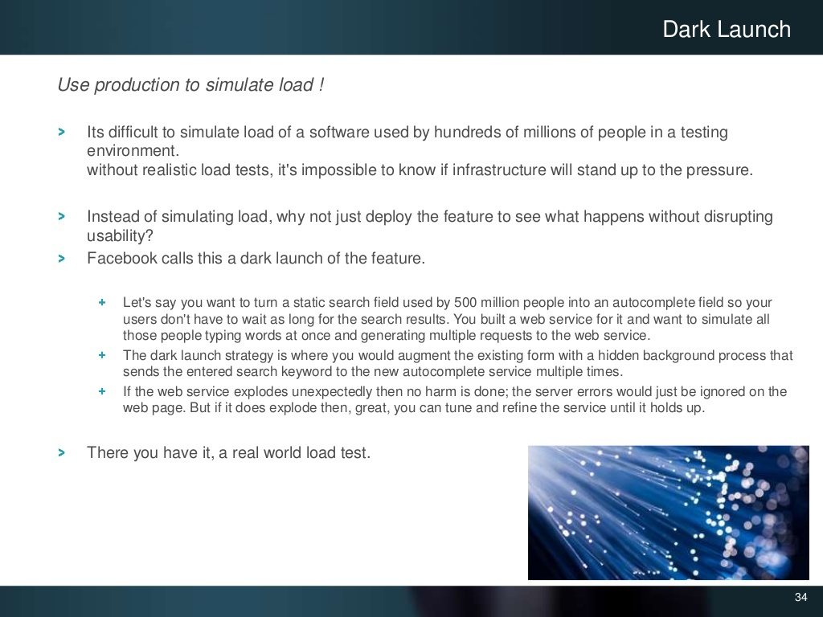
Notes:
<number>

Slide 32
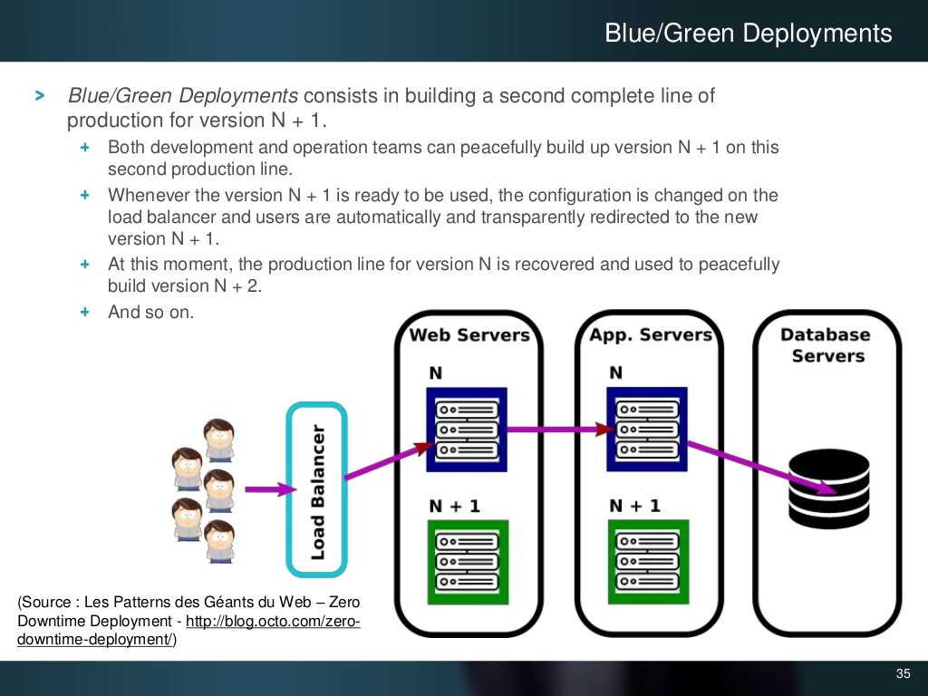
Notes:
<number>

Slide 33
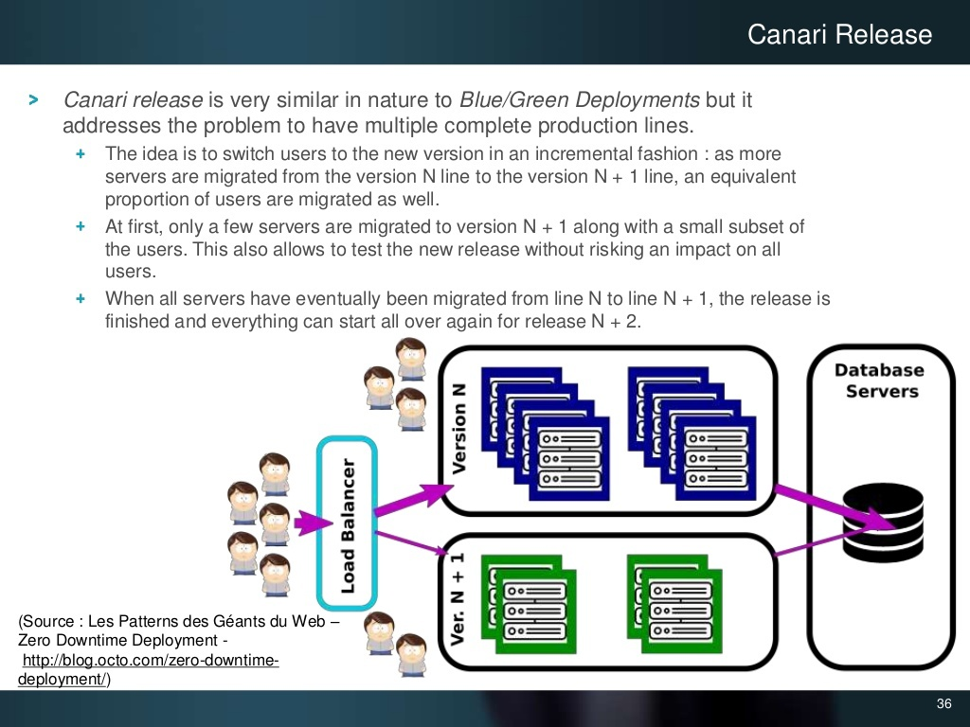
Notes:
<number>

Slide 34

Notes:
<number>

Slide 35
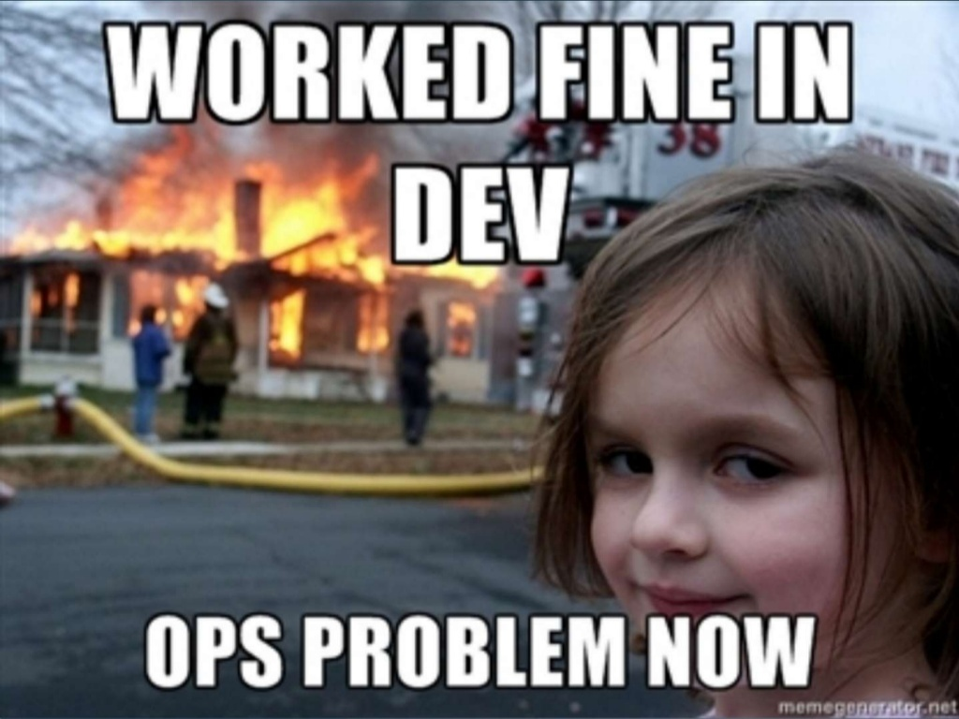
Notes:
<number>

Slide 36
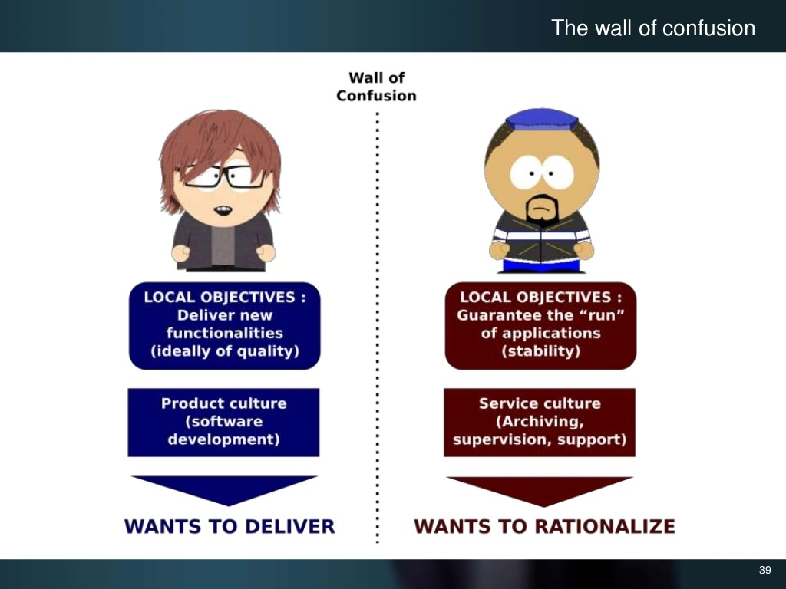
Notes:
<number>

Slide 37
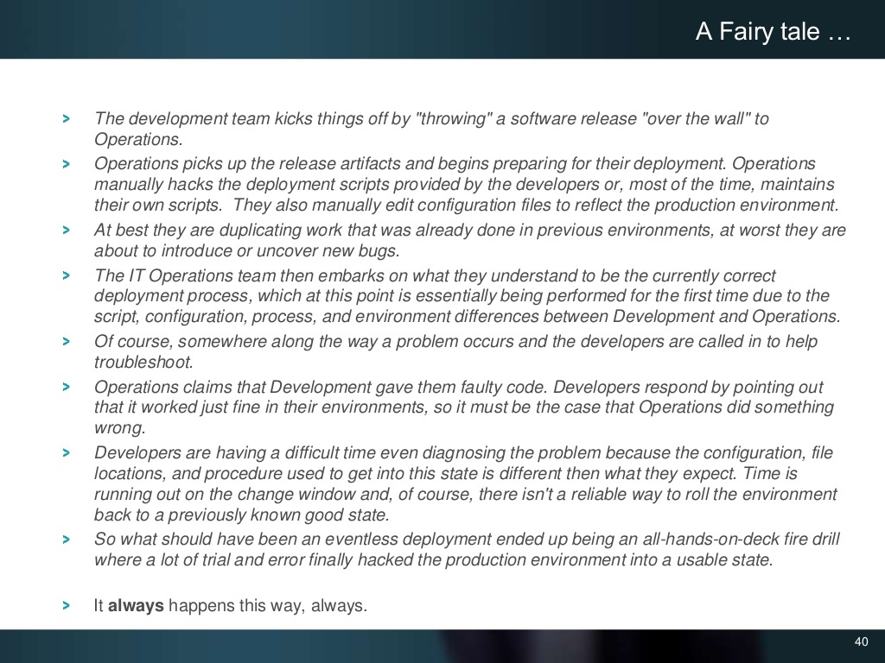
Notes:
<number>

Slide 38
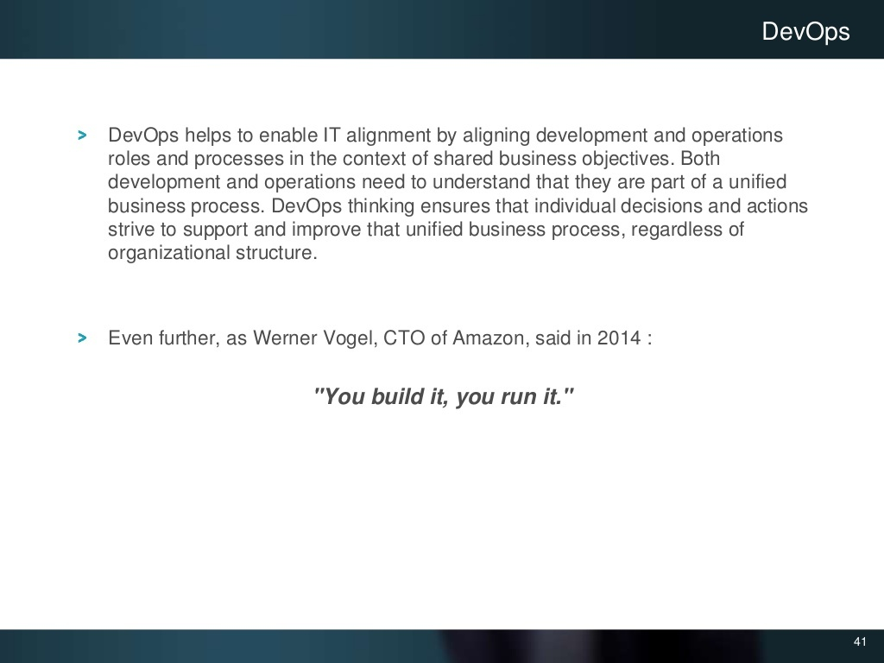
Notes:
<number>

Slide 39
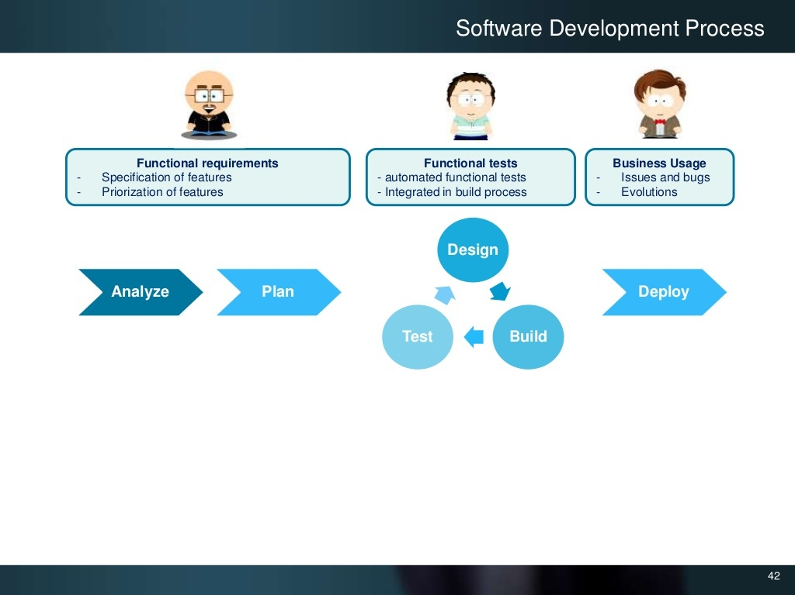
Notes:
<number>

Slide 40
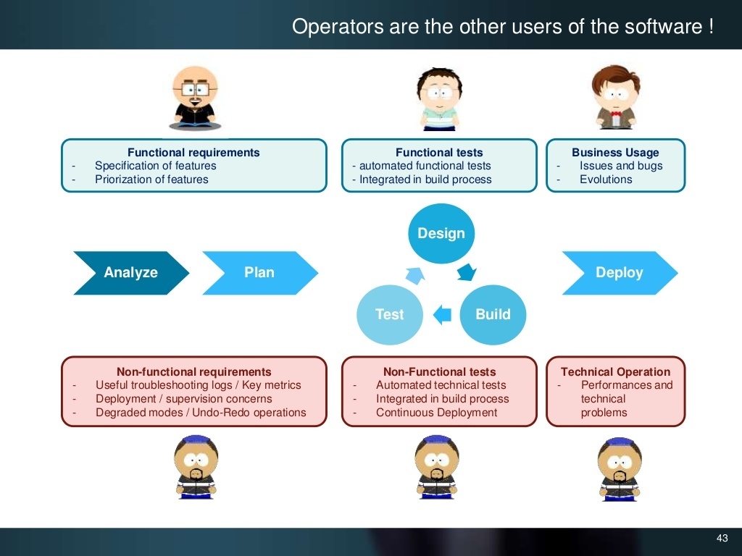
Notes:
<number>

Slide 41
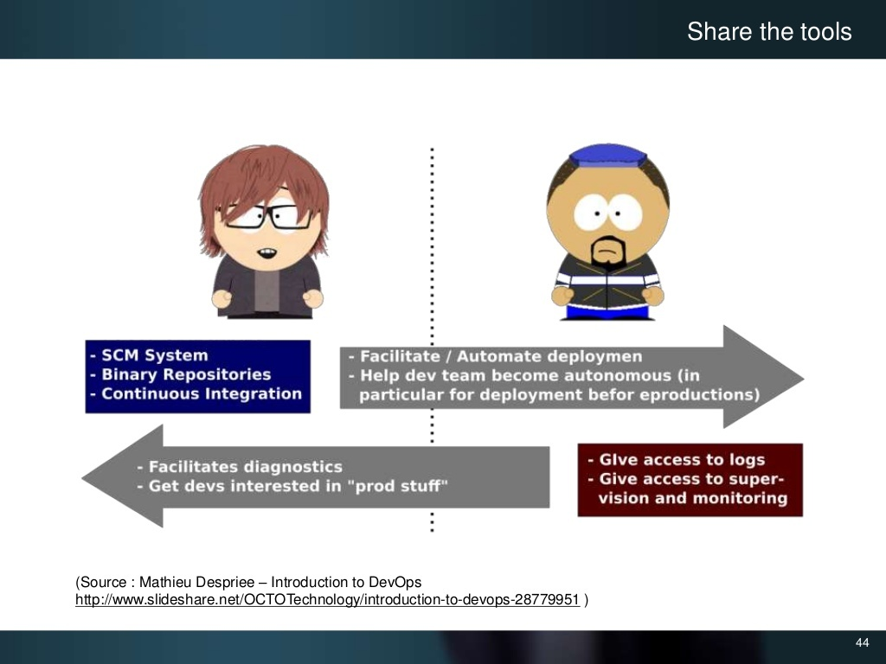
Notes:
<number>

Slide 42
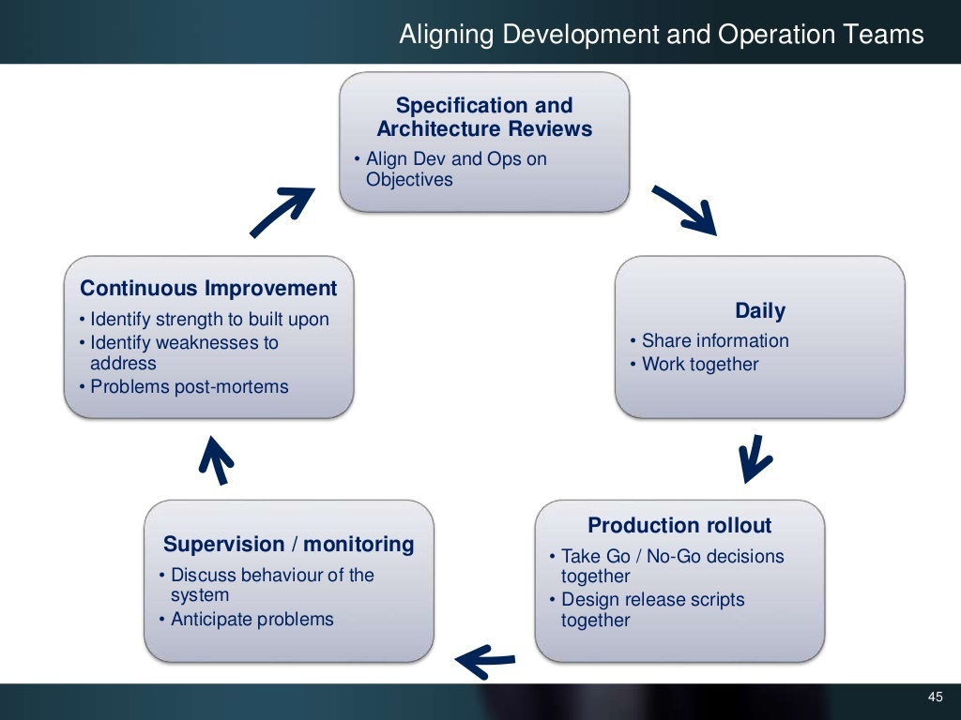
Notes:
<number>

Slide 43

Notes:
<number>

Slide 44
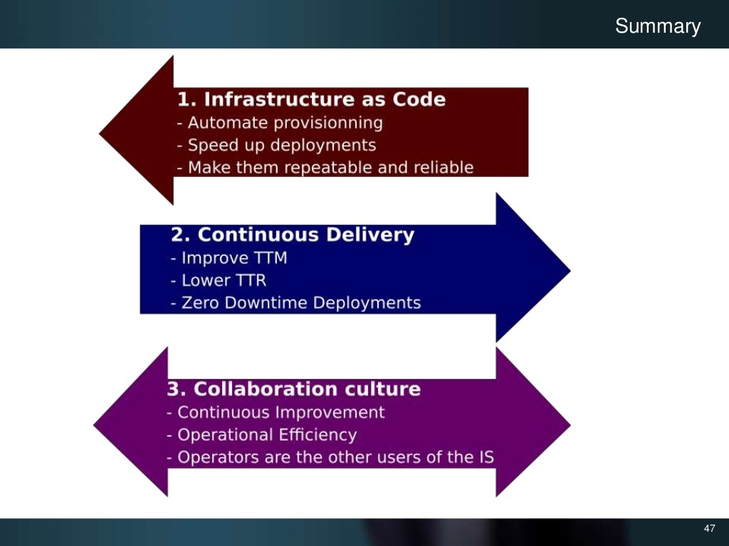
Notes:
<number>

Slide 45

Notes:
<number>

